Slide 1








Friendships,
Boundaries and
Managing Conflict
FYLDE COAST WOMEN’S AID

Slide 2
Ground Rules
RESPECT
CONFIDENTIALITY
FREEDOM OF SPEECH
BE MINDFUL OF OTHERS

Slide 3

S
A
F
E
- Say
Before We Start…..
Some of the things we discuss today may remind you of things that you or someone else has experienced.
It is okay if you need to take some of the following steps:-
Pause and leave the room
Talk about things
Just breathe and listen
*Disclaimer*: If we think you or someone else is at harm we will have to discuss this with someone else. We will always discuss this with you first
- Anything
- Feel
- Empowered

Slide 4


What we will learn today..
What is friendship and how can we spot unhealthy behaviours
Boundaries within our friendships
Managing conflict and coming to a peace
FYLDE COAST WOMEN’S AID

Slide 5

Notes:
Get the young people to stand up in a line and give the first person a phrase.
They then must relay this to the person next to them which must will eventually reach the last person who will say out load what was said
The aim of this is to see how words can be twisted. This may be due to how a person heard/ their perspective on what has been said and although sometimes no harm is meant by this, it can cause a lot of conflict
Communication is key!!!

Slide 6
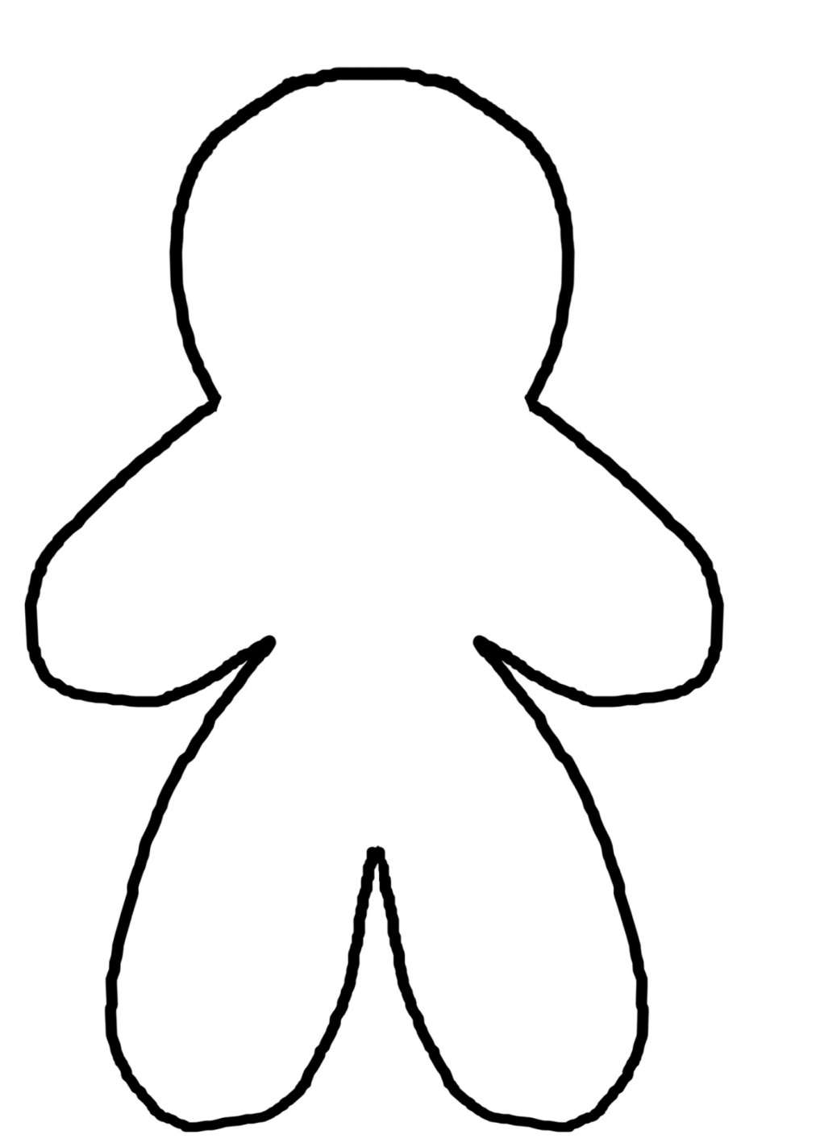

Activity – What is Friendship
On the flip chart paper provided please draw an outline of a gingerbread person.
This is your friend – Give them a name if you like……
Inside: outline all of the positive, healthy qualities and behaviours that this person has – Reflect on your own friendships if you like.
Outside: Outline the type of unhealthy, negative behaviours that this person might have.
Notes:
This can be done as a class, get them to go round and say something to put on the gingerbread
It is important to highlight that even though we identify negatives, we remain in these relationships… why?

Slide 7
Do you ever feel like you are constantly having to
and fix their problems all of the time?
Do you ever feel like your friends take advantage of you, or use your emotions for their own gain
Do you always put others before yourself?
Baggy boundaries?
Do you make choices based on how others feel?
Will you change your plans to make others happy?
Do you avoid conflict?
Do you make plans with friends and feel let down when they cancel
Do you ever find yourself apologising for how you feel?
Notes:
Why do we sometimes forget our boundaries… are we worried about managing any conflict that might come from saying ‘these are my boundaries’
Avoidance - Some people will avoid conflict at all costs this can be both positive and negative depending on the situation
Accommodating - You would be putting the concerns of others before your own. This style usually takes place when you simply give in or are persuaded to give in.
Compromise – Both people will come to an agreement whether they agree or agree to disagree
Collaborating – working together to suit the needs of both of those involved
Competing – Standing up for what is right, your morals and beliefs
No conflict should ever involve Violence in any form

Slide 8
Low self esteem, self worth, and lack of trust in others
Friendship Boundaries
Increased self-esteem and self love..
Decreased stress and worries
Building resentments towards others
Feeling like your needs do not matter
Secure and Fulfilling
Inability to concentrate at school, Failing lesson, exams etc
Independent and empowered mindset
Anxiety, depressions, self harm, isolation.

Slide 9

Positive Peace
Negative Peace
Those involved recognise new opportunities
Explorative
Build on each others solutions
Value a shared narrative
Find opportunities for greater connection over time
Recognises and has mutual concerns for others feelings
Seeks further opportunities to engage with one another
Focuses on
…............
Negotiation
…………....
Agree to
…………....
Outcome
……….......
Time
……………..
Emotions
……………..
Community
…………....
Move away from threats or violence
Transactional
Respects each others differences
Agree to disagree
May be less engaged over time
Seeks to resolve emotional conflict unless trust is violated
Co-exist and less likely to engage with one another
Notes:
PEACE – In life we will always come up against people that we will not always get along with, they will have difference of opinions, different values, their own views and perceptions.
This is okay, however we need to be mindful and respect one another and ensure that there is always peace.
There are two types of peace, there is negative peace which means agreeing to disagree and move forward from this.
Positive peace is about agreeing and moving on.
In order to achieve this the key words are – RESPECT, COMMUNICATION and UNDERSTANDING.

Slide 10
Respect each others differences
Be assertive
Know your boundaries
Communicate your
feelings
Managing Conflict
Stand by your values and beliefs
but be non judgmental and
accepting of others
Healthy arguments
Never use violence
Know your own limits with
emotional support
Agree to disagree
Accept that conflict can
be natural
Notes:
Understanding you boundaries and limits – if you are having a disagreement with someone and you know that it might turn nasty, know your own boundaries and walk away from a situation, do not raise your voice with someone who is shouting over you.
Health arguments are about listening to one another, understanding you might have difference of opinions and respecting them as a person. Negative peace would to agree to disagree.
Unhealthy arguments – there will be a power imbalance, someone will want the power and control over another person and seeks to win the argument, losing sight of the other persons feelings.

Slide 11


What help is available?
KOOTH is your online mental wellbeing community, that you can access free, and confidentially inside and outside of school. Please see your schools homepage for more details, or visit www.kooth.com
www.hideout.org.uk is a safe space where children and young people can access information to help them understand domestic abuse, and how to take positive action if it's happening to you or a person who you are close to. Here you can take a quiz to find out if your relationship is healthy.
www.loverespect.co.uk is Women’s Aid’s website for young people wanting to work out if their relationship is healthy.
Broken Rainbow
A service for lesbian, gay, bisexual and transsexual people who are experiencing domestic violence.
0300 999 5428/0800 999 5428
(run in partnership with London Lesbian and Gay Switchboard)
Notes:
Do not go away from this session with worries or concerns.
Please speak to one of us, a member of the teacher staff or even a friend, as long as they are a trusted adult.

